Slide 1
Neural ODEs for Phase
Space Estimation
By Mankrit Singh, Raghav Juyal and Yilin Tang

Slide 2
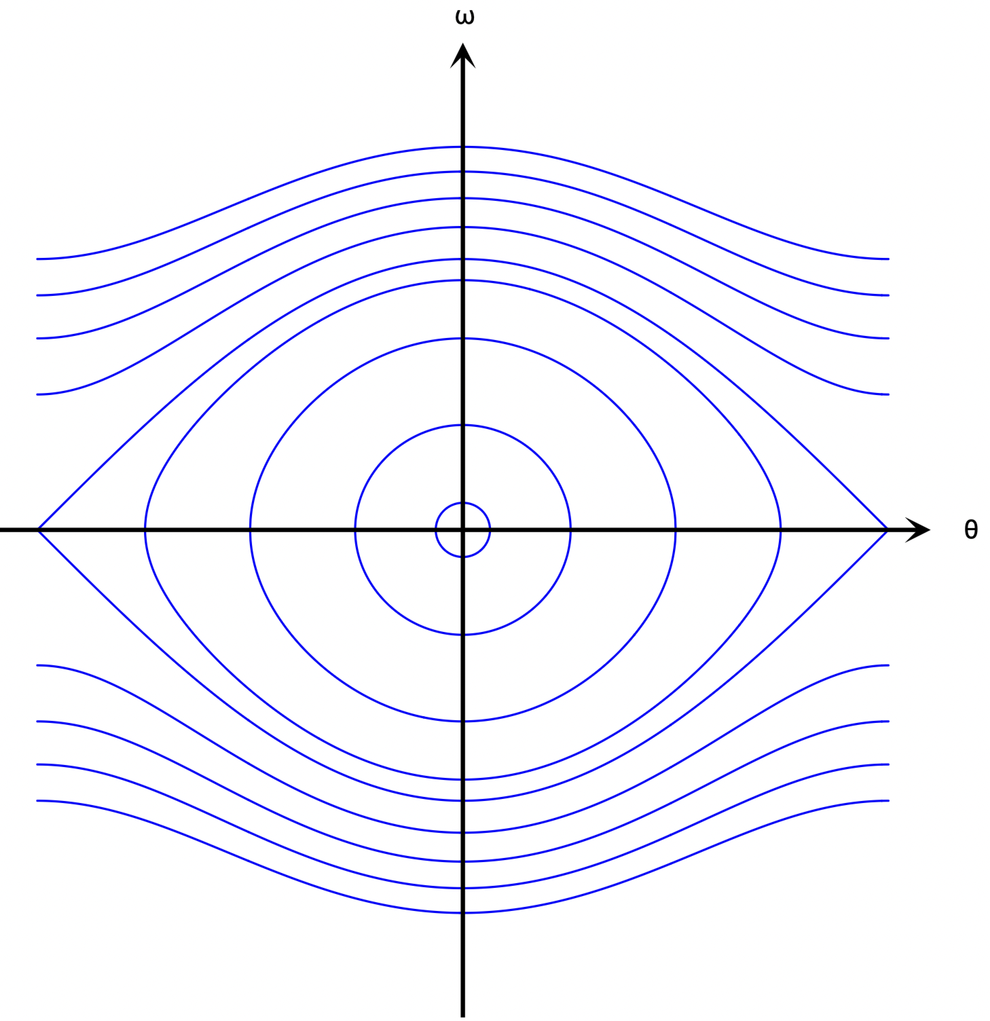
Motivation (1/2)
Dynamical Systems are everywhere.
Engineering, Physics, Economics, Biology etc.
Why do they matter?
Understanding behaviour is important
What is a Phase Space?
An abstract space that represents all possible states of a system.
Image Credits: Physics with Elliot
Notes:
Examples:
Physics: motion of planets, fluid dynamics, thermodynamics
Biology: population dynamics, neural activity
Engineering: control systems, robotics
Economics: market modeling, game theory
Why do they matter:
Predicting how systems evolve over time is essential for control, optimization and design.
Phase Space:
The phase space is a geometric representation of all possible states of a system.
Each point = one configuration (e.g., position & velocity).
The system’s trajectory traces how its state evolves over time.

Slide 3
Motivation (2/2)
Traditional modeling of dynamical systems from first principles is difficult or intractable.
Data-driven methods are the simpler and modern way to learn system dynamics directly from trajectory data.
Our Proposed Pipeline Trajectory Data → Neural ODE → Phase Space → Identify Fixed Points & Stability

Slide 4
Research Question
Can Neural ODEs accurately learn the underlying vector field of a dynamical system from trajectory data? Can the learned dynamics be used to identify fixed points and analyse their stability reliably?
Sub-Questions
How well do Neural ODEs interpolate and extrapolate?
How do activation functions affect learning of complex dynamics?
How do Neural ODEs compare to state-of-the-art methods like SINDy?

Slide 5
Related Work
Key Methods:
Neural ODEs [1]: Continuous-time neural models trained on observed trajectories.
SINDy [2]: Identifies underlying equations by applying sparse regression to a library of candidate functions.
Recent Developments:
Stable Latent Neural ODEs [3]: Trajectory-based training without needing time derivatives.
ControlSynth ODEs [4]: Designed for complex nonlinear systems with convergence guarantees.
Challenges in Chaotic Regimes [5]: ML models struggle to learn unstable dynamics (e.g., chaotic systems).
Notes:
Stable Latent: Uses Average Hausdorff Distance
CS ODEs: Uses Mean Squared Error (MSE), Mean Absolute Error (MAE), R² score, and Chamfer Distance

Slide 6
Background

Slide 7
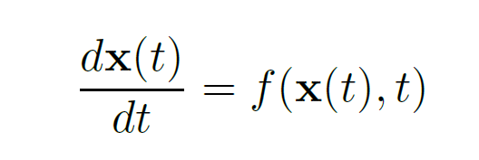
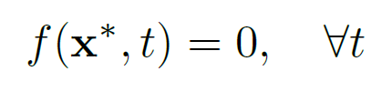
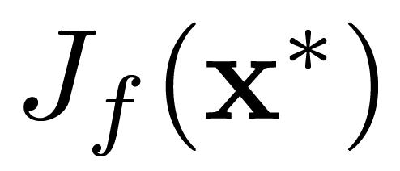
Dynamical Systems
ODE System
Fixed Point
Jacobian Matrix

Slide 8
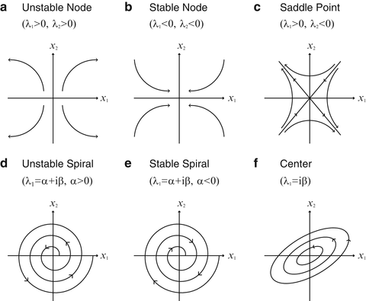
Different Types of Fixed Points
Different eigenvalues of the 2D Jacobian matrix evaluated at the fixed point give different stability and dynamics.
Figure from [6]

Slide 9
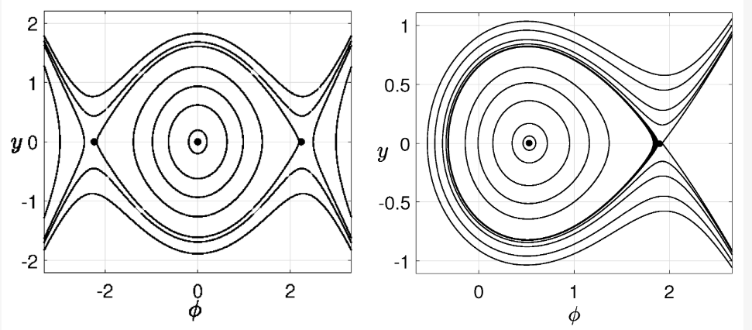
Other Dynamical Behaviours
• Limit Cycle: An isolated periodic solution, which is a closed trajectory in the phase plane, having the property that at least one other trajectory spirals into it either as t → ∞, or as t → −∞.
• Heteroclinic Orbit: A path joins two different equilibrium points in the phase space.
• Homoclinic Orbit: A path joins a saddle equilibrium point to itself in the phase space.
• Chaos: The system exhibits extreme sensitivity to initial conditions, meaning that tiny differences in starting points can lead to vastly different trajectories over time.
Figure from [7]

Slide 10
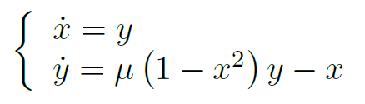
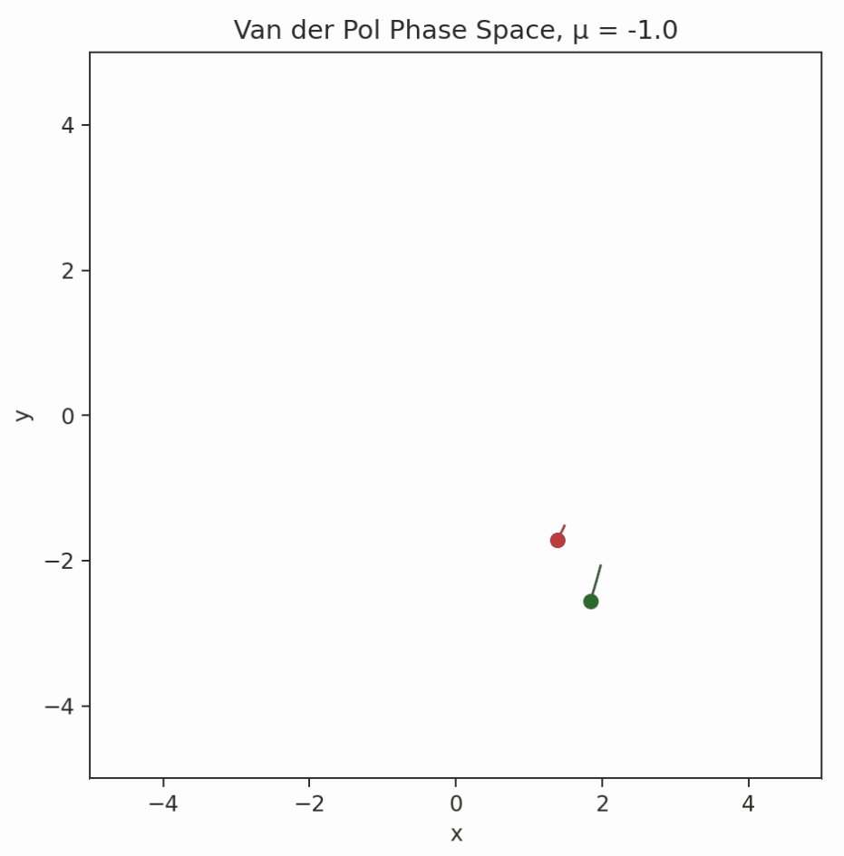
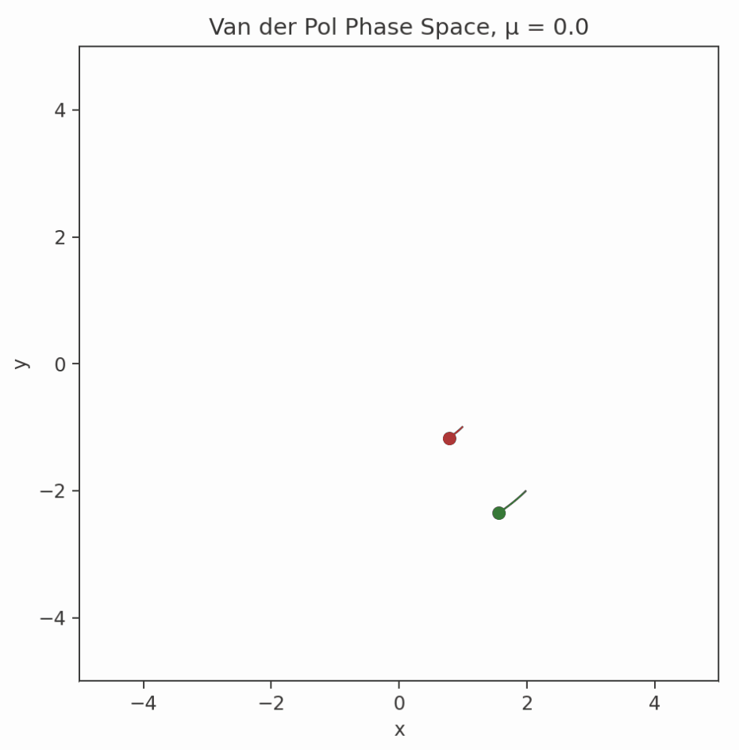
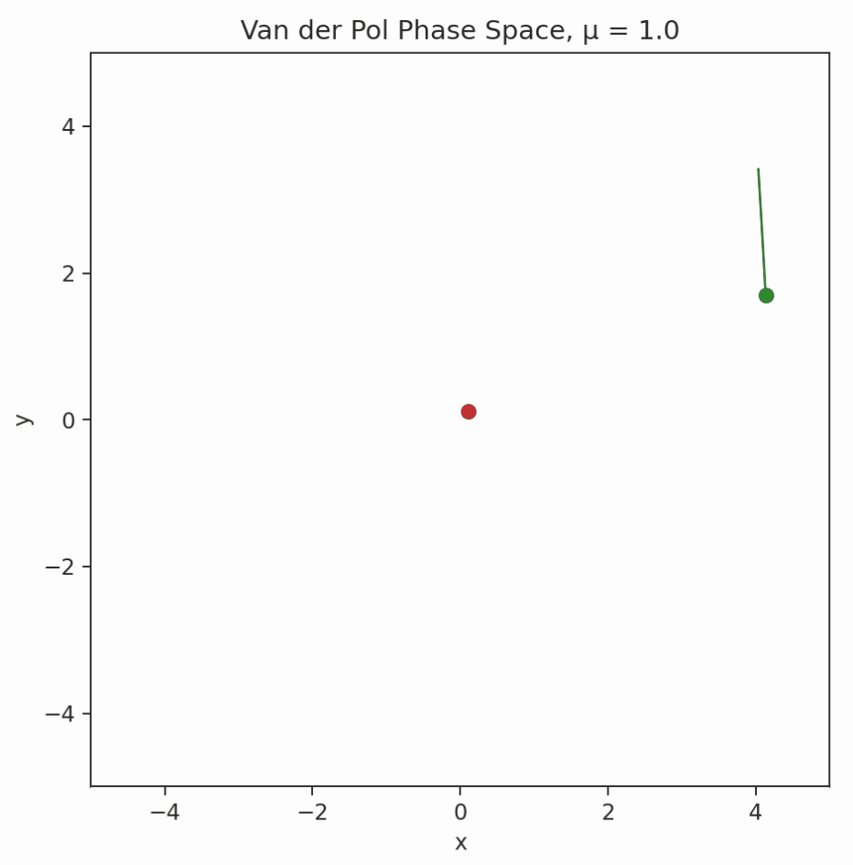
Van der Pol Equation
μ=-1
μ=0
μ=1

Slide 11
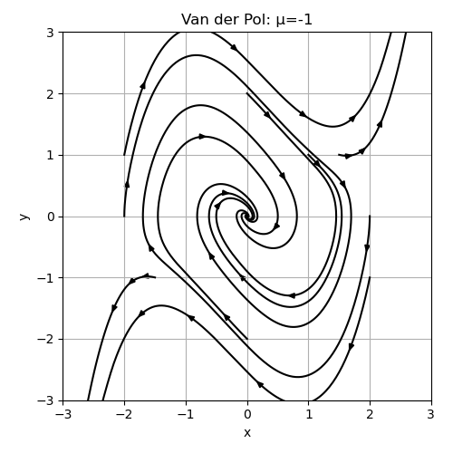
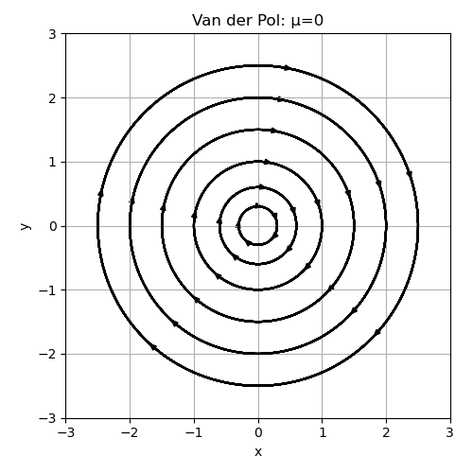
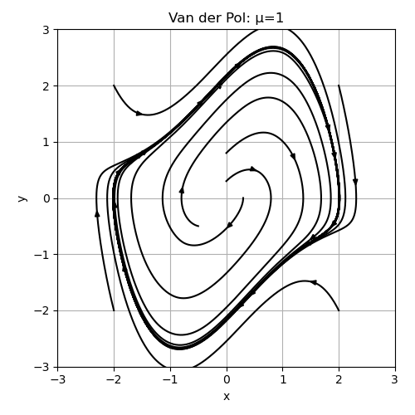
Van der Pol Equation
μ=-1
μ=0
μ=1

Slide 12
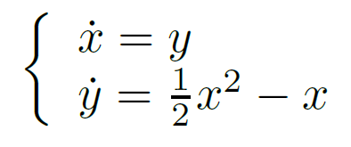
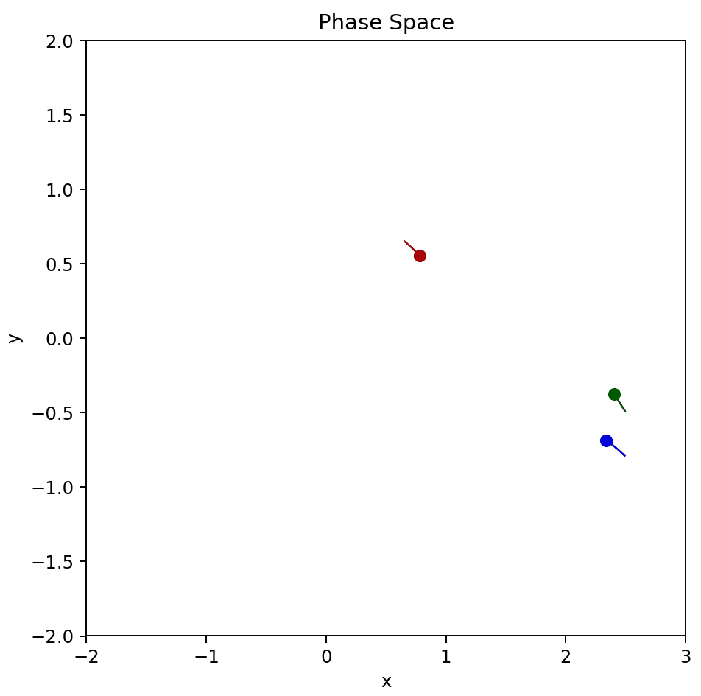
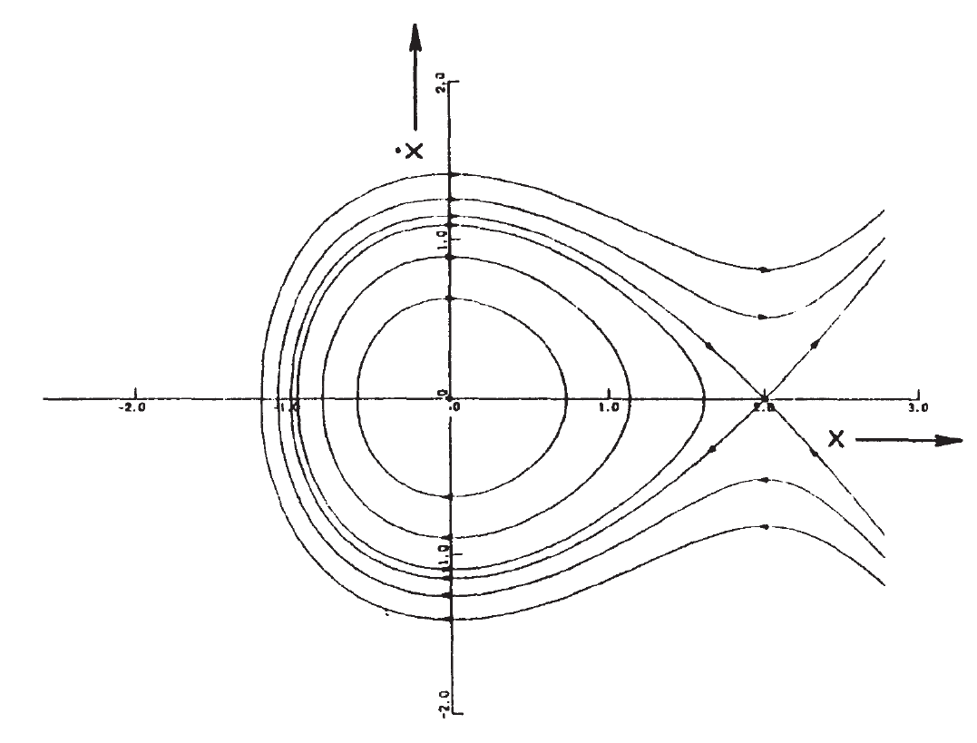
Nonlinear Homoclinic System
Figure from [8]

Slide 13
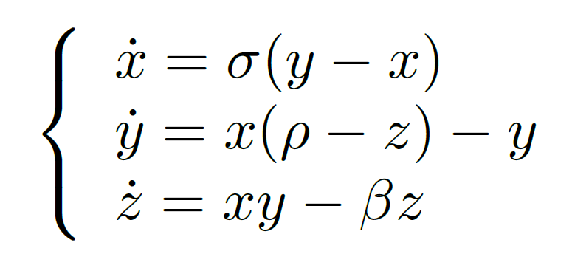
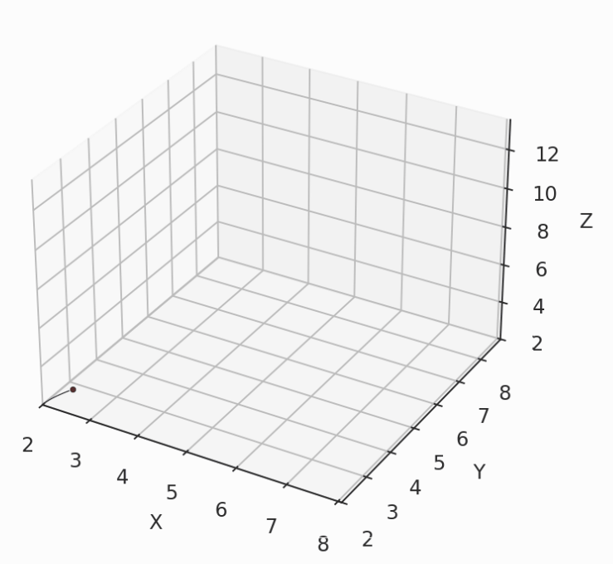
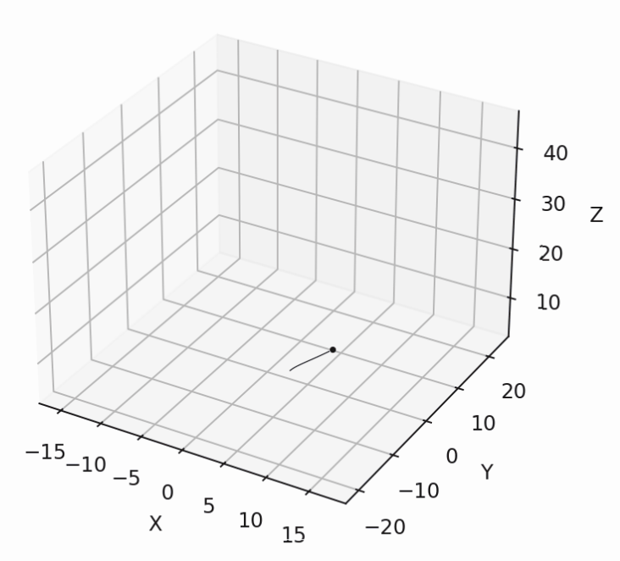
Lorenz System
Non-chaotic Lorenz
Chaotic Lorenz

Slide 14
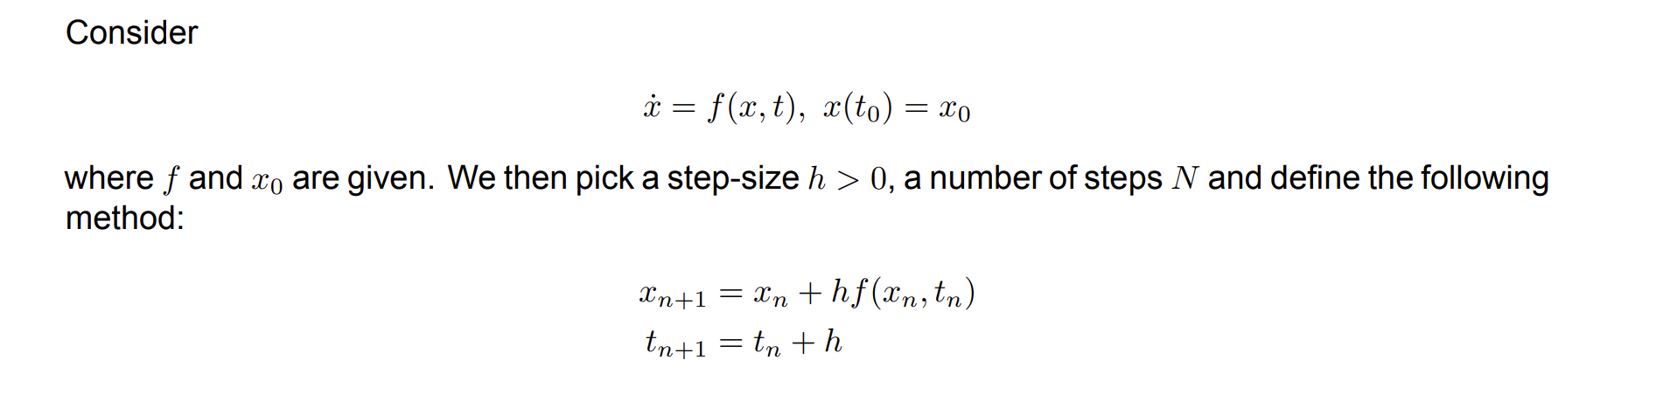
Euler Integration

Slide 15
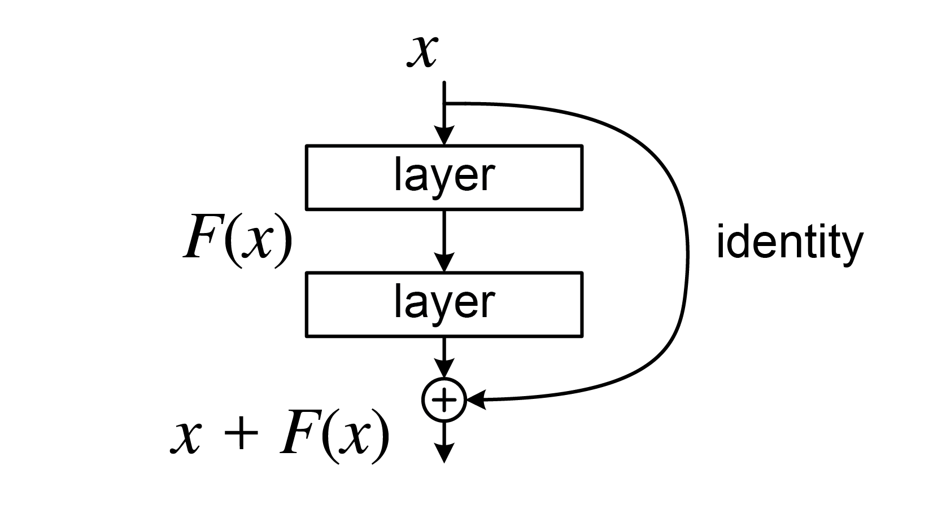
ResNet
Image Credits: Wikipedia

Slide 16
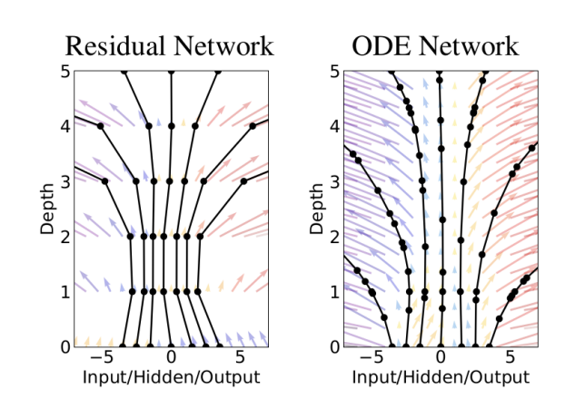
Neural ODE
Image Credits: [1]

Slide 17
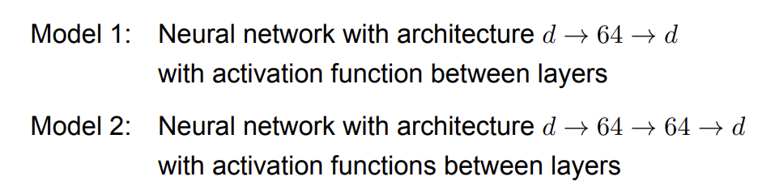
Method and Architecture Details
Give model starting points and train it to predict full trajectories
Predict trajectories for the test starting points
Model the phase space and look for the fixed points
Notes:
Dopri5

Slide 18
Identify Fix Points
• Find the minimum squared magnitude of the vector field by scipy.optimize.fmin
• Compute the Jacobian matrix via finite difference at each identified fixed point
• Compute eigenvalues of this Jacobian matrix to determine the local stability characteristics

Slide 19
Error Metrics
• Mean Squared Error (MSE): Measures the average squared difference between predicted and true trajectory points.
• Mean Absolute Error (MAE): Computes the average absolute difference between corresponding points.
• Chamfer Distance: A set-based metric that averages the distance from each point in one trajectory to its nearest neighbour in the other.
• Hausdorff Distance: Measures the maximum distance from a point in one trajectory to the nearest point in the other, capturing worst-case deviation.

Slide 20
Results

Slide 21
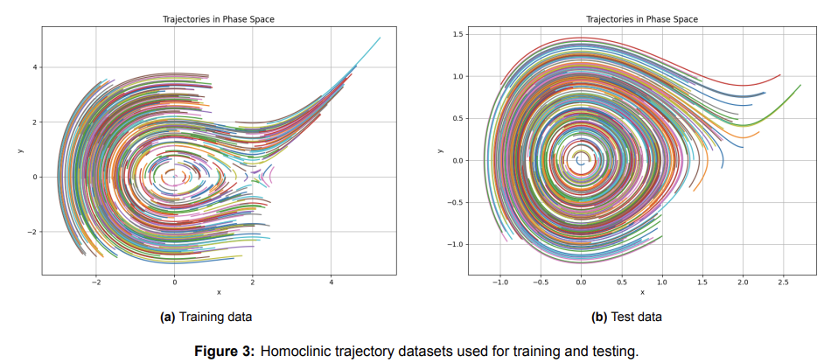
Homoclinic System

Slide 22
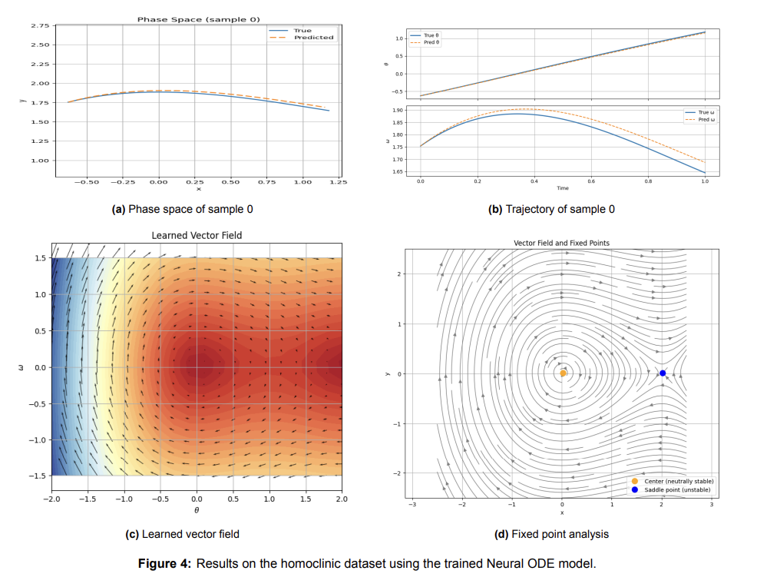
Homoclinic System

Slide 23
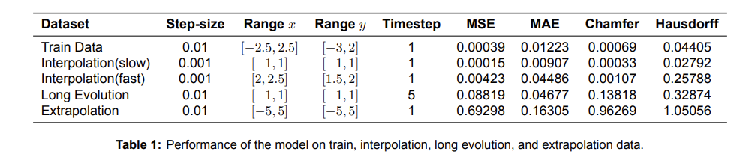
Interpolation vs Extrapolation

Slide 24
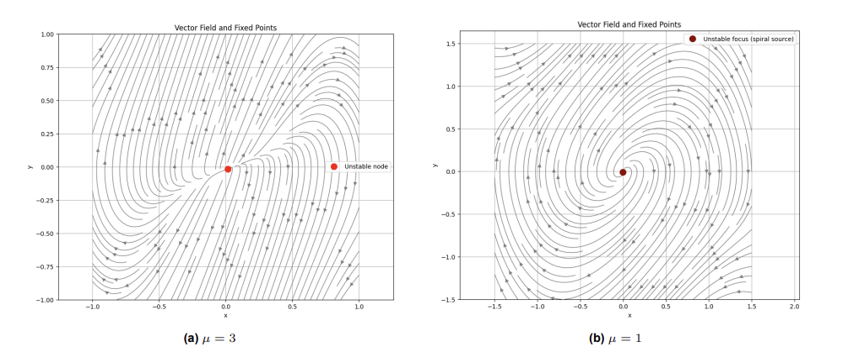
Van Der Pol System

Slide 25
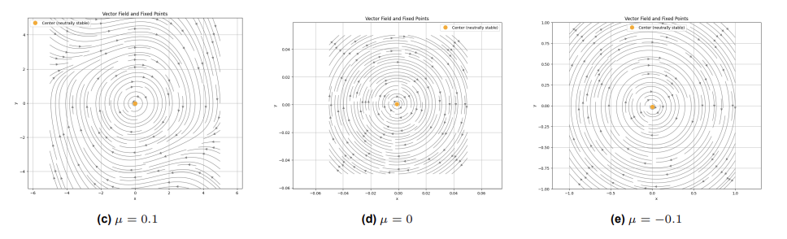
Van Der Pol System

Slide 26
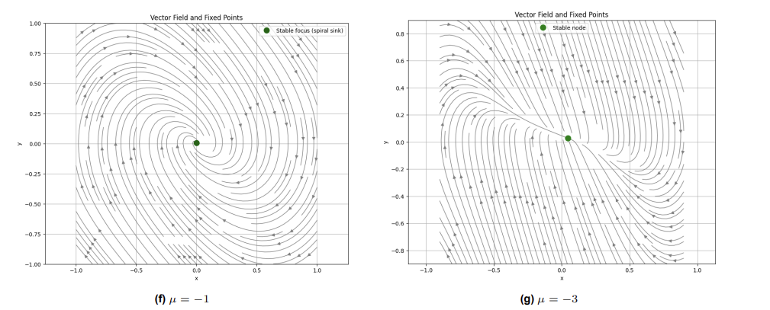
Van Der Pol System

Slide 27
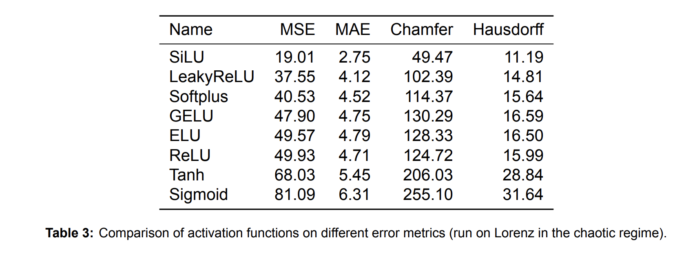
Activation Functions

Slide 28
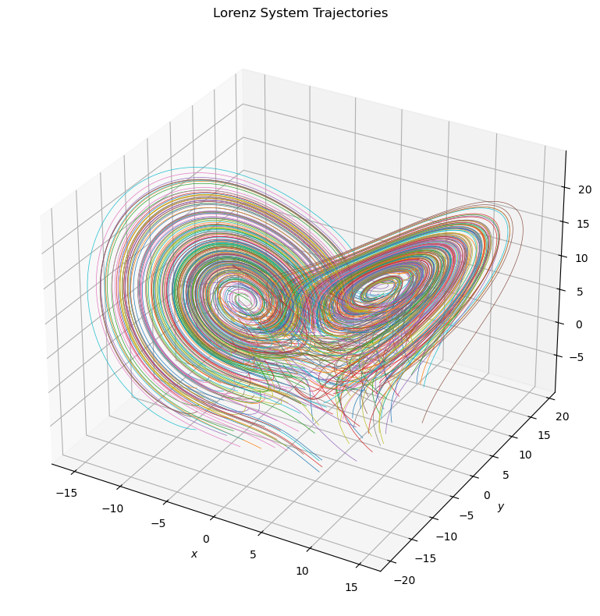
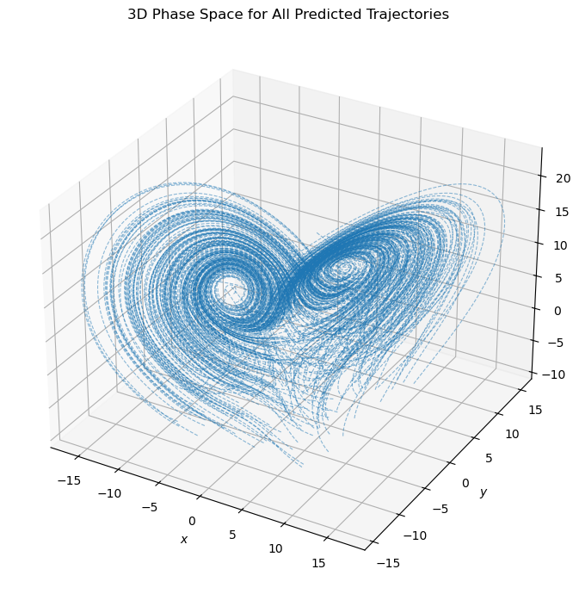
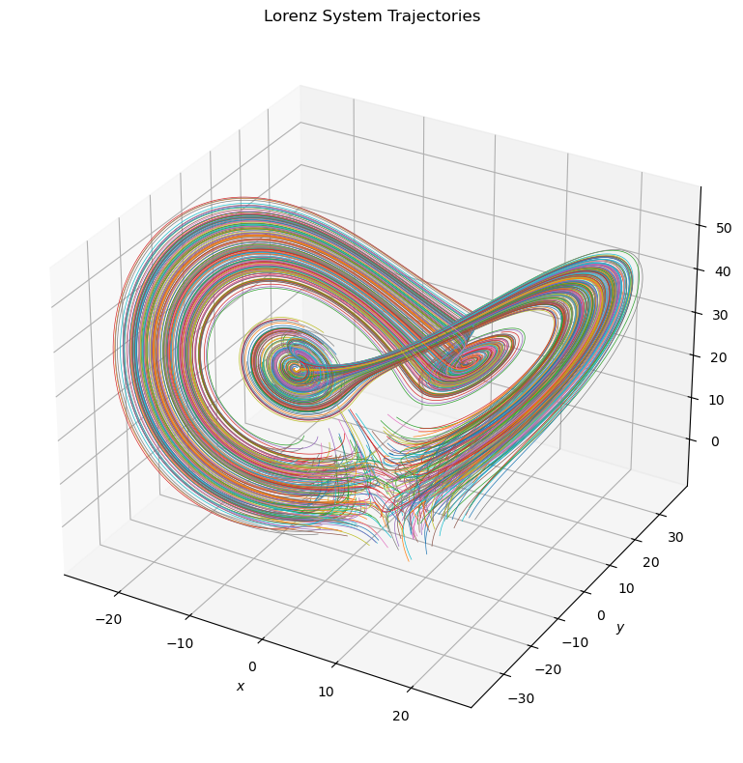
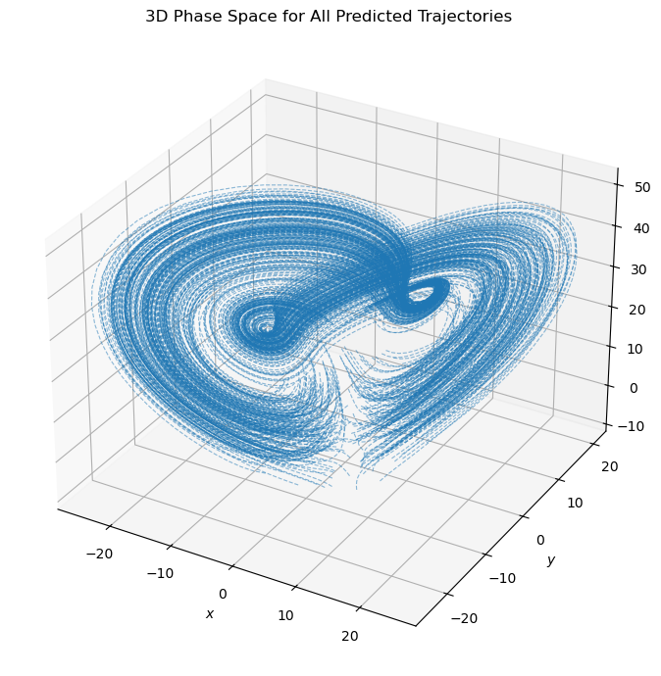
Lorenz System
Goal: Evaluate Neural ODEs on Lorenz — for chaotic and non-chaotic regimes.
Findings:
Performs reasonably well in the non-chaotic regime.
Struggles in the chaotic regime.
Higher Chamfer than Hausdorff distance
No major outliers - but poor overall match
Notes:
Small errors in the learned vector field cause large trajectory divergence.
High Chamfer distance and Low Hausdorff distance in chaotic settings indicate significant mismatch in global structure.

Slide 29
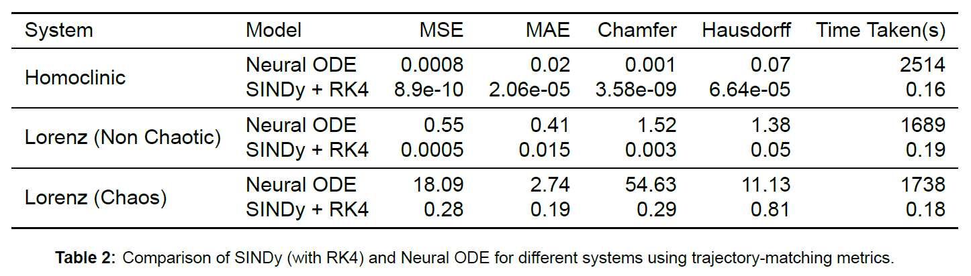
Benchmarking with SINDy + RK4
SINDy outperforms Neural ODEs
Faster and better metrics
Limitations of SINDy:
Depends on predefined function libraries.
May underfit complex or noisy systems due to sparsity bias.
Notes:
SINDy outperforms Neural ODEs across all systems and metrics (especially in chaos).

Slide 30
Conclusion
Neural ODEs can effectively recover fixed points and their stability in 2D
Strong interpolation, but struggles with extrapolation for fast-changing regions or sparse training data
Capable of capturing bifurcation phenomenon qualitatively
Struggles in the chaotic regime for the Lorenz System
SINDy outperforms Neural ODEs in training time and metrics
We used simple neural architecture
Did not tune hyperparameters extensively
SiLU performed best as the activation function
Notes:
We investigated the use of Neural Ordinary Differential Equations (Neural ODEs) as a data-driven approach to learning the underlying vector field of dynamical systems directly from trajectory data. We assessed whether these learned dynamics could reliably identify and analyse fixed points and their stability. Our results show that Neural ODEs can effectively recover fixed points and
local phase portraits in low-dimensional systems such as the 2D homoclinic system.
Yes, Neural ODEs can effectively recover fixed points and their stability in 2D systems, by generating the phase space from trajectory data.
Demonstrates strong interpolation and struggles with extrapolation for fast-changing regions or sparse training data in the phase space.
Capable of capturing bifurcation phenomenon qualitatively.
Struggles with chaotic regimes for the Lorenz System.
SINDy outperforms Neural ODEs in training time and metrics
We used simple neural architecture
Did not tune hyperparameters extensively
SiLU performed best as the activation function

Slide 31
Future Work
Model & Training Improvements:
Try deeper or more expressive neural networks
Systematic hyperparameter tuning
Implement GPU acceleration for scalability
New Directions:
Apply to real-world experimental data
Study other chaotic systems
Use autoencoders for dimensionality reduction in high-D systems
Explore one-step prediction models rather than full trajectory learning

Slide 32
References
[1]: Ricky T. Q. Chen et al. Neural Ordinary Differential Equations 2019
[2]: Steven L. Brunton et al. Discovering governing equations from data by sparse identification of nonlinear dynamical systems 2016
[3]: Andreas Sochopoulos et al. Learning Deep Dynamical Systems using Stable Neural ODEs 2024
[4]: Wenjie Mei et al. ControlSynth Neural ODEs: Modeling Dynamical Systems with Guaranteed Convergence 2024
[5]: Daniel Ayers et al. Supervised machine learning to estimate instabilities in chaotic systems: Estimation of local Lyapunov exponents 2023
[6]: Friedman A, Kao C Y. Mathematical Modeling of Biological Processes 2014
[7]: Maria Santos Bruzón et al. Generalized Camassa–Holm Equations: Symmetry, Conservation Laws and Regular Pulse and Front Solutions 2021
[8]: Ferdinand Verhulst Nonlinear Differential Equations and Dynamical Systems 1996

Slide 33
Questions

